Slide 1

PlanAI Phase 3
Team 1
System Design and Analysis

Slide 2

With PlanAI organizing your schedule has never been easier.

Slide 3

Technology
VS Code
PHP
HTML
Dbeaver
Google login/logout api

Slide 4
Overview
Initial web page
Login/new account screen
Credentials are verified and redirected to account homepage
Tasks are created, edited, deleted and completed
User information is stored in the database
Adjustable light and dark theme options
User logs out to end the session

Slide 5
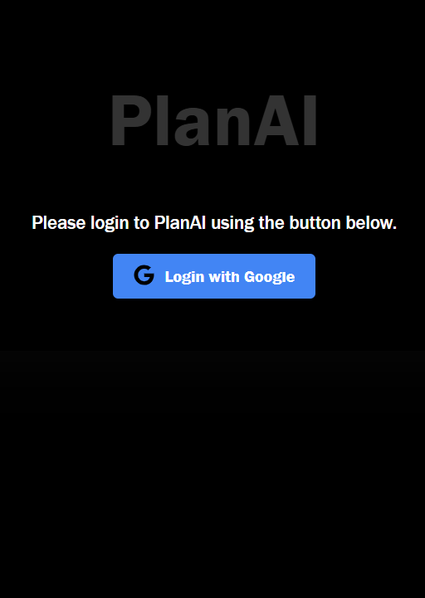
Initial Web Page
Welcome to PlanAI!
This is the first page you see when you visit our web application

Slide 6

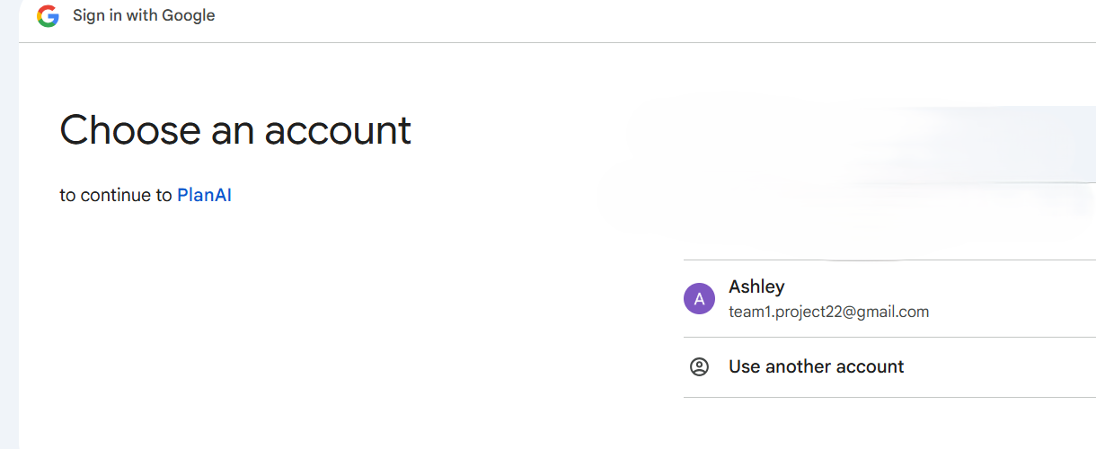
Login/create new account screen

Slide 7
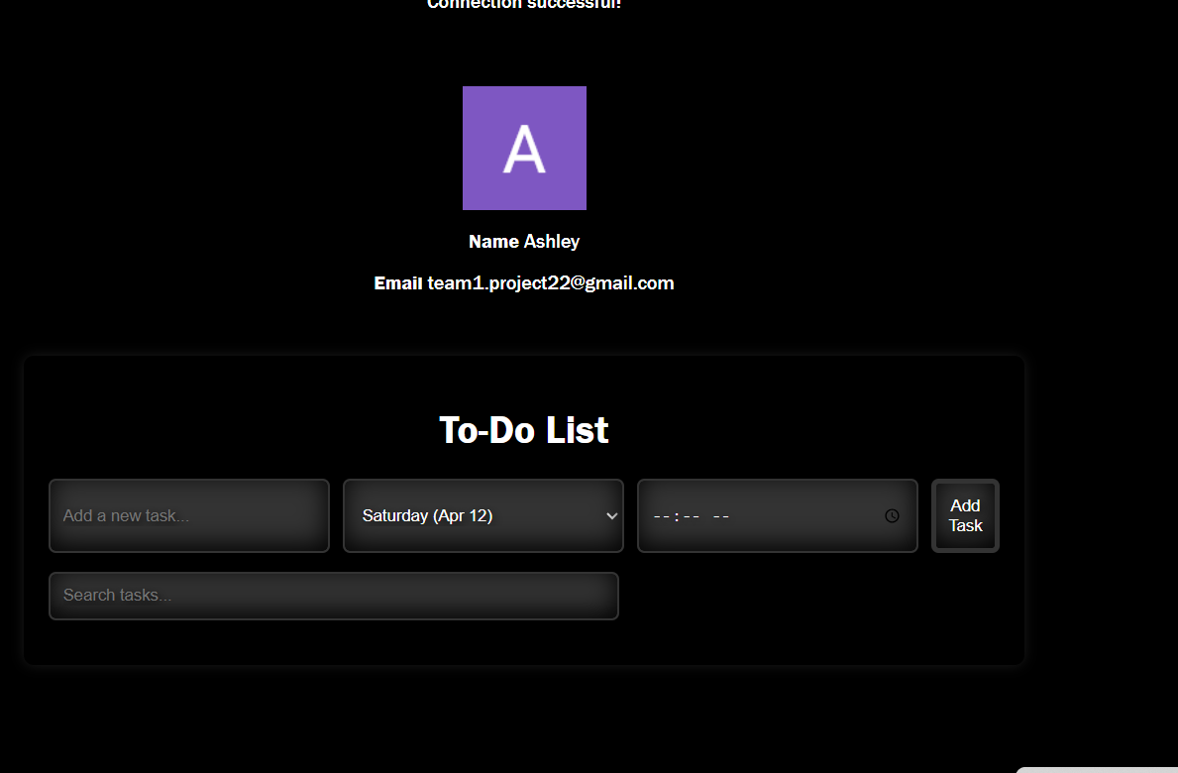
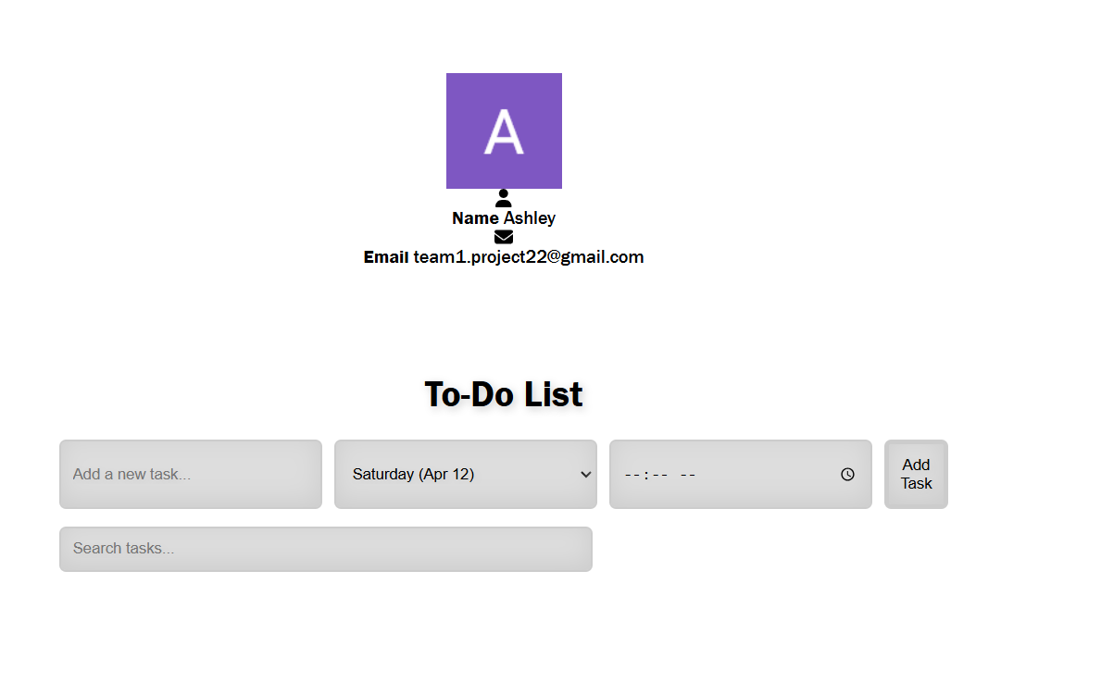
Account Home Page (with dark or light option)

Slide 8
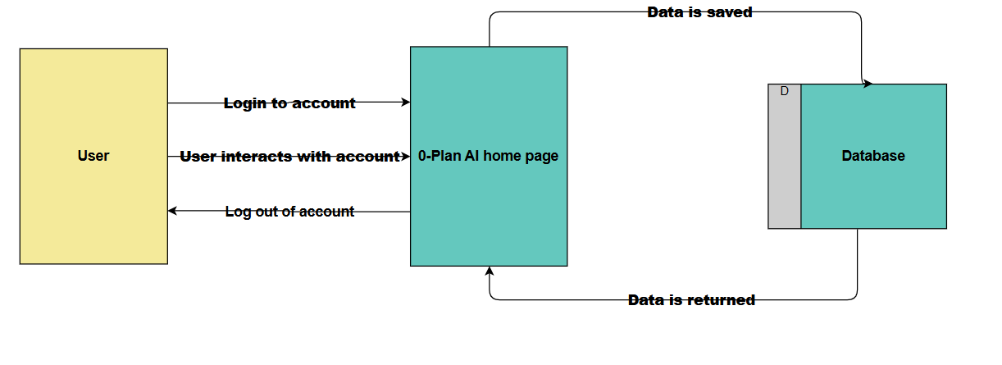
Level 0 Dataflow Diagram

Slide 9
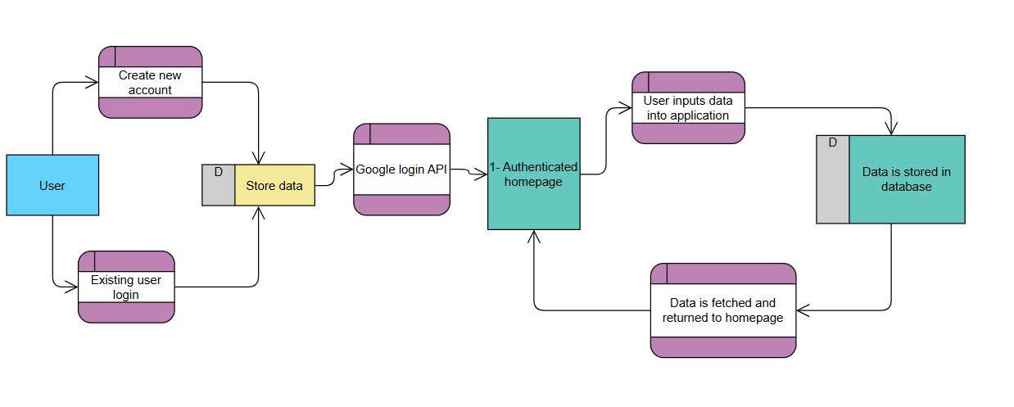
Level 1 Dataflow Diagram

Slide 10

Updates and Live Demonstration
Dark and light theme options added
Successful login and logout
Frontend and backend connected
Will continue working on UI and backend

